Slide 1
Repetitive Strain Injury Awareness Day February 29
Notes:
---------------
Reference:
*February 28 in non-leap years.

Slide 2
LAND ACKNOWLEDGEMENT
We recognize that this resource module was developed from the BCNU head office located on the unceded and traditional territories of the Squamish, Tsleil WauTuth, and Musqueam Peoples.
To find the territory/territories you are on please visit the online application from Canadian Geographic.
Please take some time to review the 94 calls to action put forward by the Truth and Reconciliation Commission to redress the legacy of residential schools and advance the process of Canadian reconciliation with Indigenous peoples.
by Haida Artist Erik Prytula - "Raven Steals the Light"

Slide 3
LEARNING OBJECTIVES
Musculoskeletal injuries
Causes
Signs and Symptoms
Prevention
Resources

Slide 4
Musculoskeletal injuries are the leading cause of injury in BC amongst healthcare workers.

Slide 5
10,579
Total MSI, strains and sprain claims in healthcare in 2022
Notes:
Reference: WSBC
These are only approved claims, not the number of reports

Slide 6
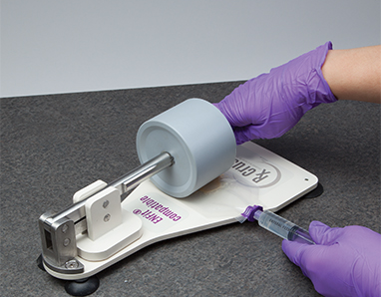
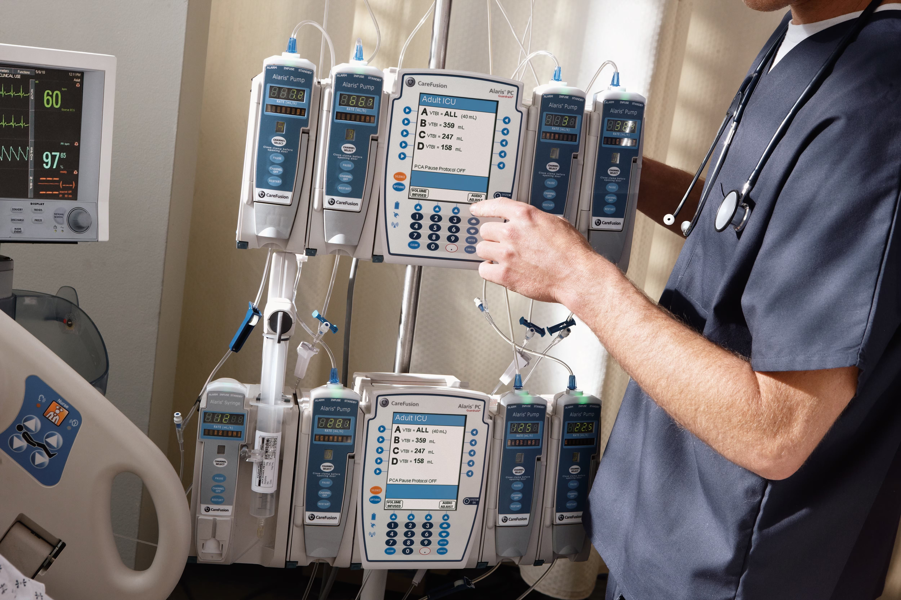
Repetitive strain injury (RSI)
In many areas of health-care delivery, your job likely requires you to perform the same task or movement over and over again.

Slide 7
PAINFUL DISORDERS AFFECTING:
Tendons
Muscles
Nerves
Joints
Soft tissues

Slide 8
BODY PARTS MOST AFFECTED
Neck
Upper & Lower Back
Shoulders
Chest
Arms, Hands, Wrists, Elbows, Fingers
Lower Limbs

Slide 9
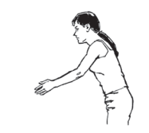
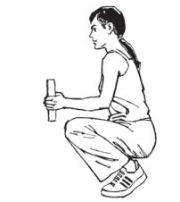
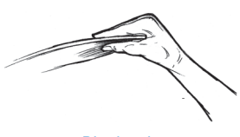
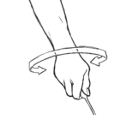
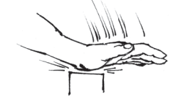
HAZARDS THAT CAUSE MSIs
Awkward postures
Static postures
Force
Repetative movements
Vibration
01
02
03
04
05
Notes:
Examples include:
Administering mass immunizations
Pill crushing
Dialysis equipment programming
Set ups such as opening sterile packages
Chemotherapy drug administration via syringe pump
Data entry
Opening blister packs

Slide 10
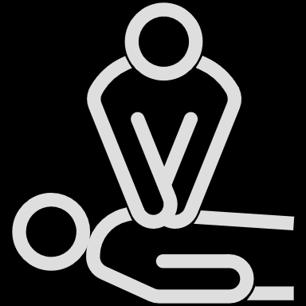
CAUSES OF MSI
Gripping
Reaching
Pulling
Holding
Pushing
Bending
Lifting
Twisting
Typing
Clenching

Slide 11
SIGNS AND SYMPTOMS
Joint stiffness
Muscle tightness
Redness or swelling of the affected area
Loss of range of motion
“Pins and needles”
Numbness
Skin colour change
Decreased sweating of the hands
Pain and discomfort

Slide 12
REFLECTIONS
Risk factors for MSI/RSI: awkward postures, repetition, force, reaching, bending, twisting, lifting, gripping, pulling.
What work activities are related to your noted signs and symptoms? Are there risk factors involved?
What changes to your work environment, equipment, tools or work processes would improve the situation?

Slide 13
PREVENTION
EDUCATION
RISK CONTROL
IDENTIFICATION AND REPORTING
EVALUATION
CONSULTATION
RISK IDENTIFICATION AND ASSESSMENT
TRAINING

Slide 14
MAKE A DIFFERENCE IN YOUR WORKPLACE…
MEMBERS
STEWARDS
JOHSC REPS
Seek first aid
Follow up with your doctor
Report hazards, injuries and near misses
WorkSafeBC claim for time loss
Union Management
Meetings
Walk abouts
Discuss at JOHS Committee
MSI Assessment and Prevention plans
Ergonomic Assessment

Slide 15
… BECAUSE WORK SHOULDN’T HURT
Attend to your pain or discomfort – seek first aid and your physician
Report your pain to your employer
Health Authorities: Workplace Health Contact Centre: 1-866-922-9464
Affiliates/independents: Use your employer’s reporting process
Take action to control hazards in the workplace. Participate in the incident investigation to identify corrective actions.
#PreventRSI

Slide 16
REFERENCES
WorkSafeBC Ergonimics
Occupational Health and Safety Regulations 4.46-4.53
Canadian Centre for Occupational Health and Safety
Occupational Health Clinics for Ontario Workers Inc.
NBA PCA Article 32
Notes:
<Facilitator>speaks to content in notes/facilitates discussions/check chat when asking for people to post in there
<Producer > manages slides/supports facilitator. Pastes in chat:
WorkSafeBC Ergonomics:
https://www.worksafebc.com/en/health-safety/hazards-exposures/ergonomics
OHS Reguluations 4.46-4.53: Ergonomics
https://www.worksafebc.com/en/law-policy/occupational-health-safety/searchable-ohs-regulation/ohs-regulation/part-04-general-conditions#SectionNumber:4.46
Canadian Centre for Occupational Health and Safety
https://www.ccohs.ca/events/rsi/
Occupational Health Clinics for Ontario Workers Inc
https://www.ohcow.on.ca/injury-prevention/musculoskeletal-disorders_msd/
NBA PCA
https://www.bcnu.org/contracts-and-bargaining/your-collective-agreement
<Producer > <advance slide>

Slide 17
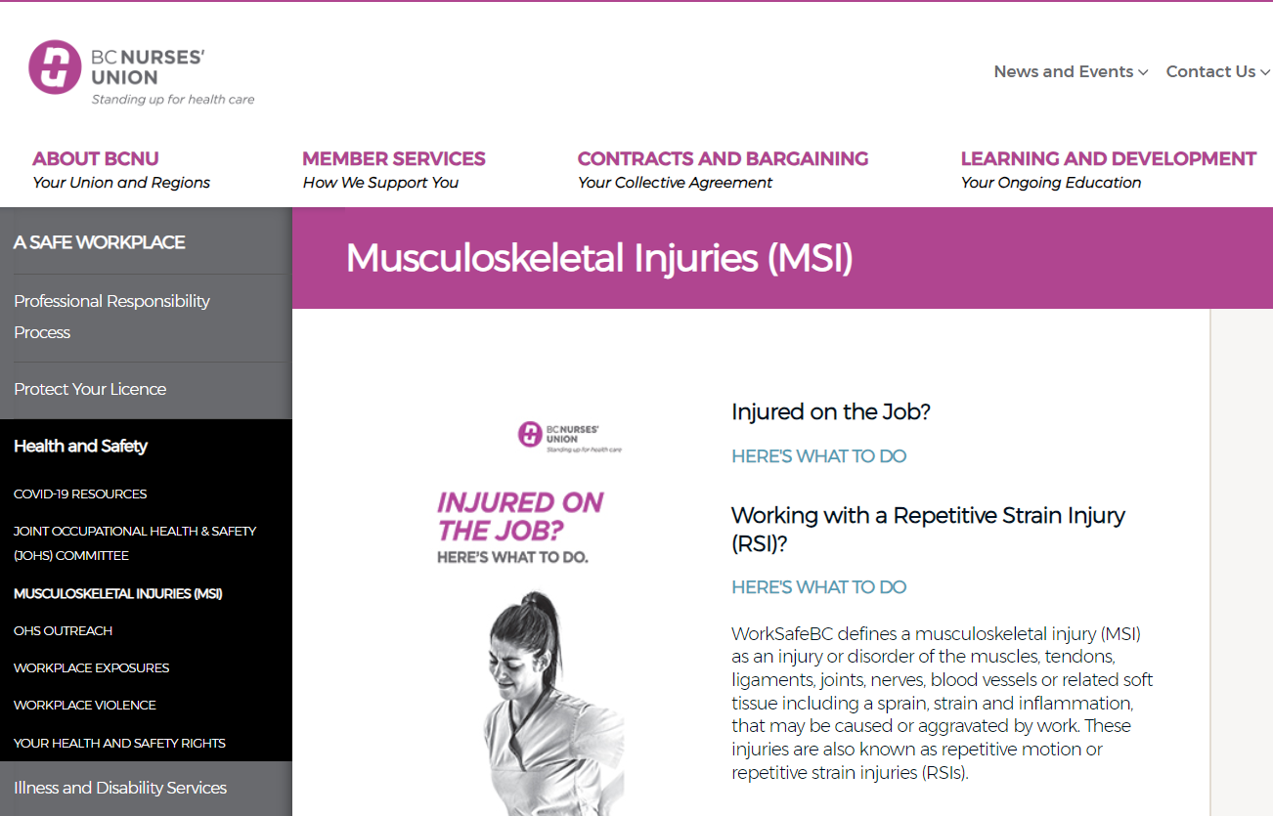
QUESTIONS?
Regional OHS Rep:
Email address
Healthandsafety@bcnu.org
Notes:
<Facilitator>speaks to content in notes/facilitates discussions/check chat when asking for people to post in there
<Producer > manages slides/supports facilitator
<Producer > <advance slide>

